Slide 1
INTRODUCTION
IoT-Based Health Monitoring Systems represent a significant advancement in healthcare technology, leveraging the power of the Internet of Things (IoT) to remotely track and monitor vital health parameters. These systems offer a convenient and efficient way to collect and analyze health data, enabling proactive healthcare management and Improving overall patient outcomes.
In this project, we have designed the IoT Based Patient Health Monitoring System using ESP8266 & Arduino.

Slide 2
IoT-based health monitoring systems consist of several interconnected components that work together to provide comprehensive health data and insights. These components include:
Wearable Sensors: These devices are designed to measure various physiological parameters such as heart rate, blood pressure, and temperature. They are typically non-invasive and easy to use, making them suitable for long-term monitoring.
IoT Gateway: The IoT gateway serves as a bridge between the wearable sensors and the cloud-based platform. It collects data from the sensors, processes it, and securely transmits it to the cloud for further analysis.

Slide 3
Cloud Platform: A centralized cloud platform is essential for storing, processing, and analyzing the collected health data. It provides a secure and scalable environment for data management and enables advanced analytics capabilities. The cloud platform can be used to identify trends, detect anomalies, and generate personalized insights for healthcare providers and patients.
Mobile Application: A user-friendly mobile application is often provided to facilitate patient interaction with the health monitoring system. The app allows patients to view their health data, and communication.

Slide 4
LITERATURE SURVEY
Vaneeta Bhardwaj, Rajat Joshi, Anshu Gaur (2021)- Doctors can easily monitor patient’s health using the suggested model. Use of edge computing the information transfer can be made more secure. The system integrates Internet of Things (IoT) technology, enabling cloud-based data tracking and the addition of advanced features and biological sensors. This makes the system adaptable and future-ready.
C R Srinivasan, Guru Charan, P Chenchu Sai Babu (2019)- In order to increase the Accuracy of the readings multiple sensors can be used to get an average value of the same reading. Any object connecting to IoT demands a unique IP address or mode of identification that can be attained using IPv6.

Slide 5
Norbahiah Misran, Mohammad Shahidul Islam, Gan Kok Beng, Mohammad Tariqul Islam, Nowshad Amin (2019)- The IoT has a diversity of application domains in which IoT for healthcare is still in the top of the research because of its potentiality. Besides, developing technologies of IoT such as (Radio frequency identification)RFID, cloud computing, wireless network technologies (BLE, Wi-Fi, ZigBee) and (Low power wireless area network) LPWAN technologies like LoRa and SigFox are promising in terms of the IoT application development in a large scale and they are contributing to improve the device connection to the internet as well as the efficiency of the IoT application operation.
Alexandros Pantelopoulos, Nikolaos G. Bourbakis (2010)- In general, a lot of the biosensors used in current wearable systems tend to have bulky size. Power consumption (and battery size) appears to be perhaps the biggest technical issue and performance bottleneck in current implementations.

Slide 6
. Mohammad Monirujjaman Khan, Turki M. Alanazi, Amani Abdulrahman Albraikan, Faris A. Almalki (2023)- The IoT is now considered one of the most desirable solutions inhealth monitoring. It makes sure that the parameter data issecured inside the cloud, and the most important thing isthat any doctor can monitor the health of any patient at anydistance. The sensors used in the system can be improved, andwe can measure several health parameters when additionalsensors are added.

Slide 7
OBJECTIVES
Real-time Health Monitoring- Enable continuous tracking of patient vitals such as heart rate, oxygen levels, blood pressure, and temperature. Provide instant feedback to healthcare professionals for timely diagnosis and intervention.
Remote Access to Patient Data- Allow doctors and caregivers to remotely access patient data through cloud-based storage, reducing the need for physical presence.
User Friendly Interface- Present health data in easy-to-understand charts and graphs, avoiding overwhelming users with too much information. Accessible via smartphones, tablets, and desktop computers to accommodate different user preferences.

Slide 8
Adaptability and Upgradability- Design the system to be flexible and scalable, allowing future upgrades and the incorporation of emerging IoT technologies. Ensure the system can accommodate new features without the need for significant infrastructure changes.
Improved Patient Care and Outcomes- Simplify patient care by enabling more efficient diagnosis, treatment, and continuous monitoring. Enhance the quality of healthcare by reducing human error and improving response times.
Cost Effective Solution-Remote monitoring reduces the need for frequent hospital or clinic visits, saving costs for patients and healthcare providers. IoT sensors and devices are generally affordable and easy to install, reducing the initial setup cost.

Slide 9
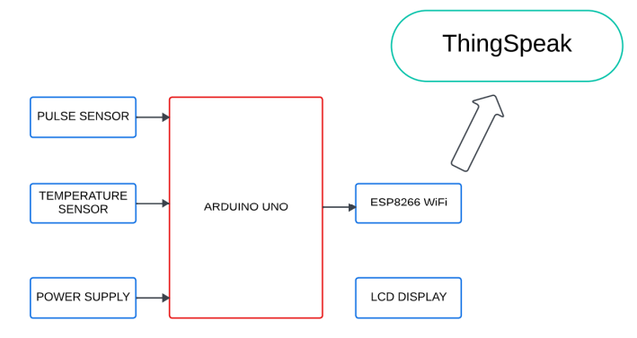
METHODOLOGY ADOPTED
This block diagram explains the IoT Based Patient Health Monitoring System using ESP8266 & Arduino. Pulse Sensor and LM35 Temperature Sensors measure BPM & Environmental Temperature respectively. The Arduino processes the code and displays it to 16*2 LCD Display. ESP8266 Wi-Fi module connects to Wi-Fi and sends the data to IoT device server.

Slide 10
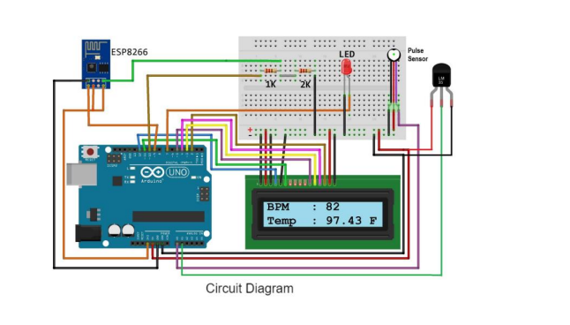
Circuit diagram of the system

Slide 11
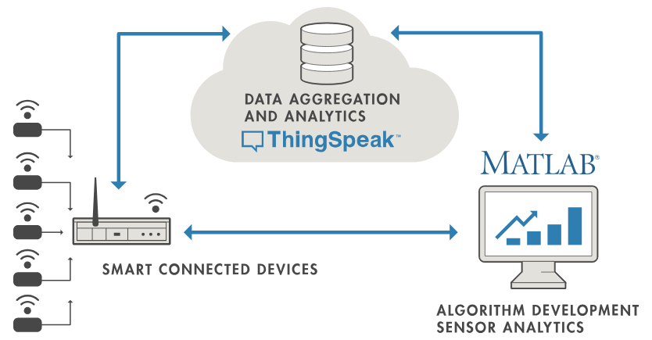
Tools Used
ThingSpeak- ThingSpeak is an open-source software written in Ruby which allows users to communicate with internet enabled devices.
ThingSpeak is an IoT analytics platform service that allows you to aggregate, visualize, and analyze live data streams in the cloud. You can send data to ThingSpeak from your devices, create instant visualization of live data, and send alerts.

Slide 12
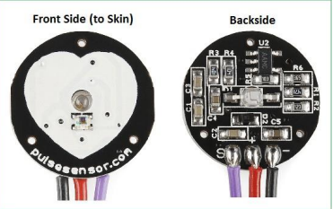
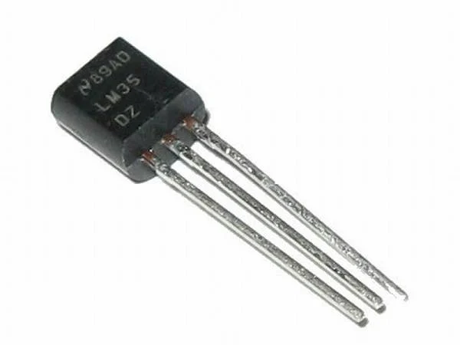
Pulse Sensor
The Pulse Sensor is a plug-and-play Pulse sensor for Arduino.
Clip the Pulse Sensor to your fingertip and plug it into your Arduino, you can ready to read heart rate.
LM35 Temperature Sensor
LM35 is a temperature measuring device having an analog output voltage proportional to the temperature.
It provides output voltage in Centigrade (Celsius).
It is a 3-terminal sensor used to measure temperature ranging from -55 °C to 150 °C.
LM35 gives output which is more precise than thermistor output.

Slide 13
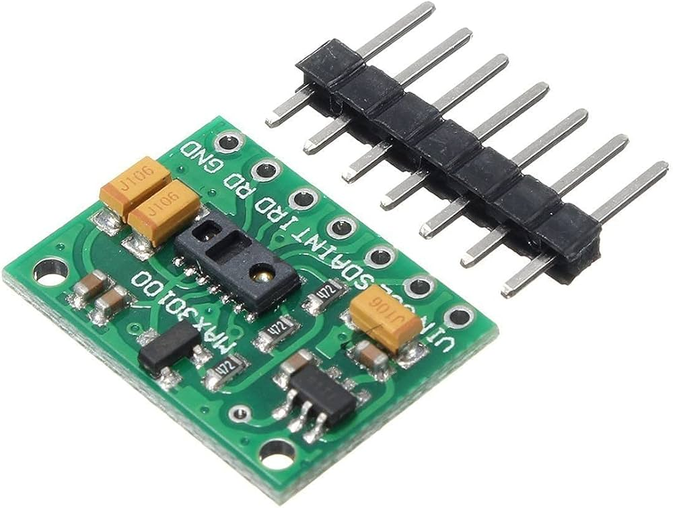
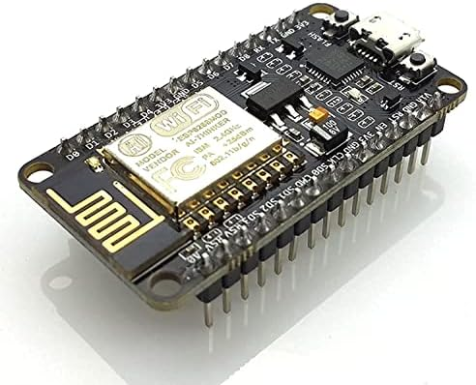
Max 30100
The MAX30100 is an integrated pulse oximeter and heart-rate sensor. It is designed to measure the oxygen saturation in the blood and heart rate.
Low power consumption, making it suitable for battery-operated devices.
Easy integration with common microcontrollers due to I2C interface.
ESP8266
The ESP8266 is a Wi-Fi module that allows microcontrollers to connect to a Wi-Fi network.
It’s widely used in IoT applications and is known for its affordability and ease of integration.

